Slide 1
Algorithms
Analysis & Design
Lecture 1

Slide 2
Lecturer: Dr. Tarek Morad
E-mail: hagras@gmail.com
Textbook: Introduction to Algorithms, Cormen, Leiserson, Rivest, Stein
(second edition)

Slide 3
Runtime Sorting Example
Sort1()
{
int A[4]= {1,5,3,7},
i,j,k1;
for( i = 0; i < v-1; i++)
{
for( j = i+1; j<v; j++)
if( A[j] < A[i] )
{ k1 = A[i]; A[i] = A[j]; A[j]=k1;}
}
}
Sort2()
{
int A[4]= {1,5,3,7}, F[4]={0,0,0,0},
i,j,k1;
for(i=0;i<v-1;i++)
{
F[i]=1;
for(j=0;j<v;j++)
if(F[j] == 0 && A[j] < A[i])
{k1=A[i]; A[i]=A[j]; A[j]=k1;}
}
}

Slide 4
Constants Cost Example
Sort1()
{
int A[4]= {1,5,3,7},
i,j,k1;
for( i = 0; i < v-1; i++)
{
for( j = i+1; j<v; j++)
if( A[j] < A[i] )
{ k1 = A[i]; A[i] = A[j]; A[j]=k1;}
}
}
Sort3()
{
int A[4]= {1,5,3,7},i,j,k,k1,F,min;
for(i=0;i<v-1;i++)
{
min = A[i];
for(j=i+1;j<v;j++)
if(A[j]<min) {min=A[j]; k=j; F=1;}
if ( F==1)
{ k1 = A[i]; A[i] = A[k]; A[k] = k1;}
}
}

Slide 5
Algorithm
An algorithm is any well-defined computational procedure that takes some value, or set of values as input and produce some value or set of values, as output.
An algorithm is a sequence of computational steps that transform input into output.

Slide 6
Algorithm Analysis
Computational Model
(uniprocessor- Random Access Memory (RAM))
  All memory equally expensive to access
  No concurrent operations
  All reasonable instructions take unit time
    Except, of course, function calls
  Constant word size

Slide 7
Input Size
Number of items
Number of bits
Number of nodes and edges

Slide 8
Algorithm Quality Measure
Predicting the resources
(memory, communication band width, hardware)
Most often the computational time
(running time)

Slide 9
Insertion Sort
ISERTION-SORT()
For j ← 2 to length[A]
do key ← A[j]
» Insert A[j] into the sorted sequence A[1…j-1]
i ← j – 1
while i > 0 and A[i] > key
do A[i+1] ← A[i]
i ← i – 1
A[i+1] ← key

Slide 10


Insertion Sort
ISERION-SORT() cost times
For j ← 2 to length[A] c₁ n
do key ← A[j] c₂ n-1
» Insert A[j] into the sorted sequence A[1…j-1] 0 n-1
i ← j – 1 c₄ n-1
while i > 0 and A[i] > key c₅
do A[i+1] ← A[i] c₆
i ← i – 1 c₇
A[i+1] ← key c₈ n-1

Slide 11
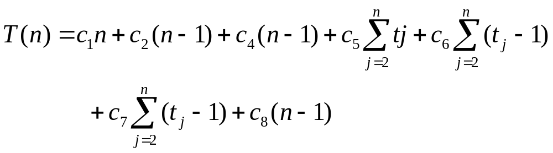
Insertion Sort Running Time

Slide 12
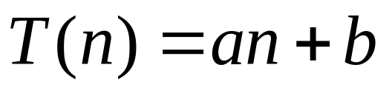
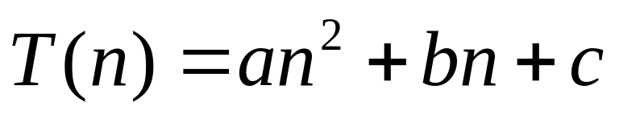
Best Case: t_{j}=1
Worst Case: t_{j}=j

Slide 13
The divide-and-conquer approach
Divide the problem into number of subproblem.
Conquer the subproblems by solving them recursively.
Combine the solutions to subproblems into the solution for the original problem.
Merge Sort
Divide: divide the n-element sequences to be sorted into two subsequences of n/2 elements each.
Conquer: sort the two subsequences recursively using merge sort.
Combine: merge the two sorted subsequences to produce the sorted answer.

Slide 14
Merging
MERGE(A,p,q,r)
n₁ ← q – p + 1 10. i ← 1
n₂ ← r – q 11. j ← 1
Create array L[1..n₁+1] and R[1..n₂+1] 12. for k ← p to r
For i ← 1 to n₁ 13. do if L[i] ≤ R[j]
do L[i] ← A[p + i - 1] 14. then A[k] ← L[i]
For j ← 1 to n₂ 15. i ← i + 1
do R[j] ← A[q + j] 16. else A[k] ← R[j]
L[n₁+1] = ∞ 17. j ← j + 1
L[n₂+1] = ∞

Slide 15
Merge Sort
MERGE-SORT(A,p,r)
If p < r
then q ← ⎣ (p+r)/2 ⎦
MERGE-SORT(A,p,q)
MERGE-SORT(A,q+1,r)
MERAGE(A,p,q,r)

Slide 16
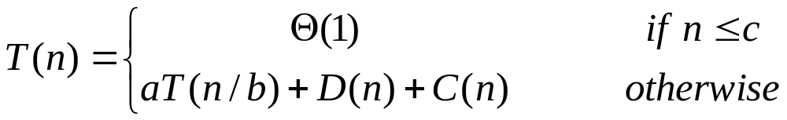
Analysis of Divide-and-Conquer
Divide the problem into number of a subproblem each of which is 1/b size of the original problem D(n).
Combine the solutions to subproblems into the solution for the original problem C(n).

Slide 17
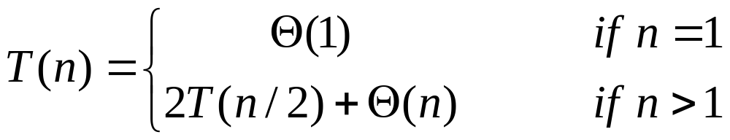
Analysis of Merge-Sort
Divide the problem into number of 2 subproblems each of
which is 1/2 size of the original problem
D(n) = Θ(1).
Conquer recursively solve two subproblems, each of size
n/2, which contributes 2T(n/2) to the running time.
Combine C(n)= Θ(n) .

Slide 18
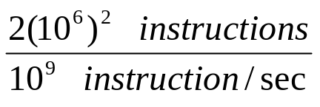
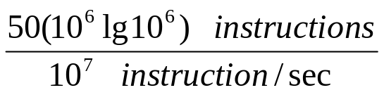
Algorithm Efficiency
Computer A
Insertion Sort (c₁n²)
n=1,000,000
10⁹ instruction/sec
C₁=2
2000 sec
Computer B
Merge Sort (c₂nlgn)
n=1,000,000
10⁷ instruction/sec
C₂=50
100 sec

